Slide 1

MEE 342: PRINCIPLES OF MECHANICAL DESIGN
DESIGN & ANALYSIS OF F-14 LANDING GEAR
Touchdown Mechanics
Aditya Sally
Anuj Shastry
Emily Lopez
Joshua Raya
Kevin Ruiz Lopez
Sanad Dababneh
Instructor: Yi Ren | February 2, 2026

Slide 2

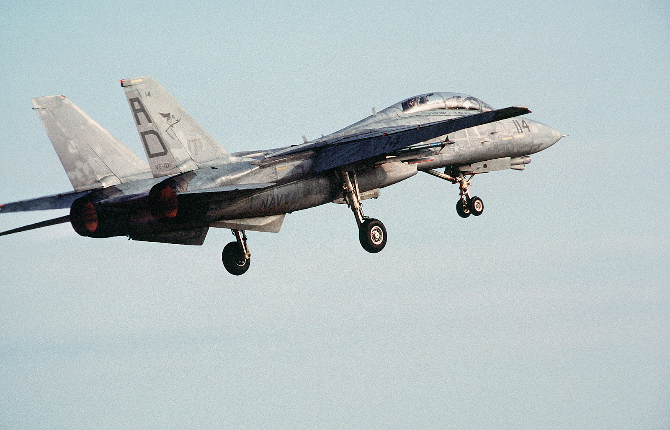

SYSTEM ANALYSIS OUTLINE
▪
Executive Summary: The role of landing gear in carrier aviation.
▪
System Description: Operating conditions and constraints.
▪
Sub-Systems: Key mechanical components.
▪
Kinematics: Degrees of freedom and retraction path.
▪
Design Analysis: Modeling for 3D printed prototypes.
▪
Failure Modes: Risk assessment (FEA).

Slide 3

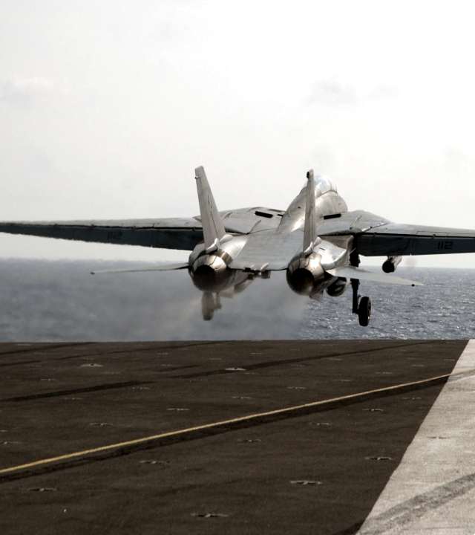
THE CRITICAL INTERFACE
The landing gear is the sole interface between the airframe and the ground. It is a multidisciplinary system requiring integration of:
▪
Structural Mechanics: Supporting 60,000+ lbs loads.
▪
Dynamics: Absorbing high-energy impact shocks.
▪
Kinematics: Complex retraction into limited volumes.
Unlike commercial aircraft, naval interceptors like the F-14 must withstand "controlled crashes" onto carrier decks, demanding exceptional redundancy and mechanical robustness.

Slide 4
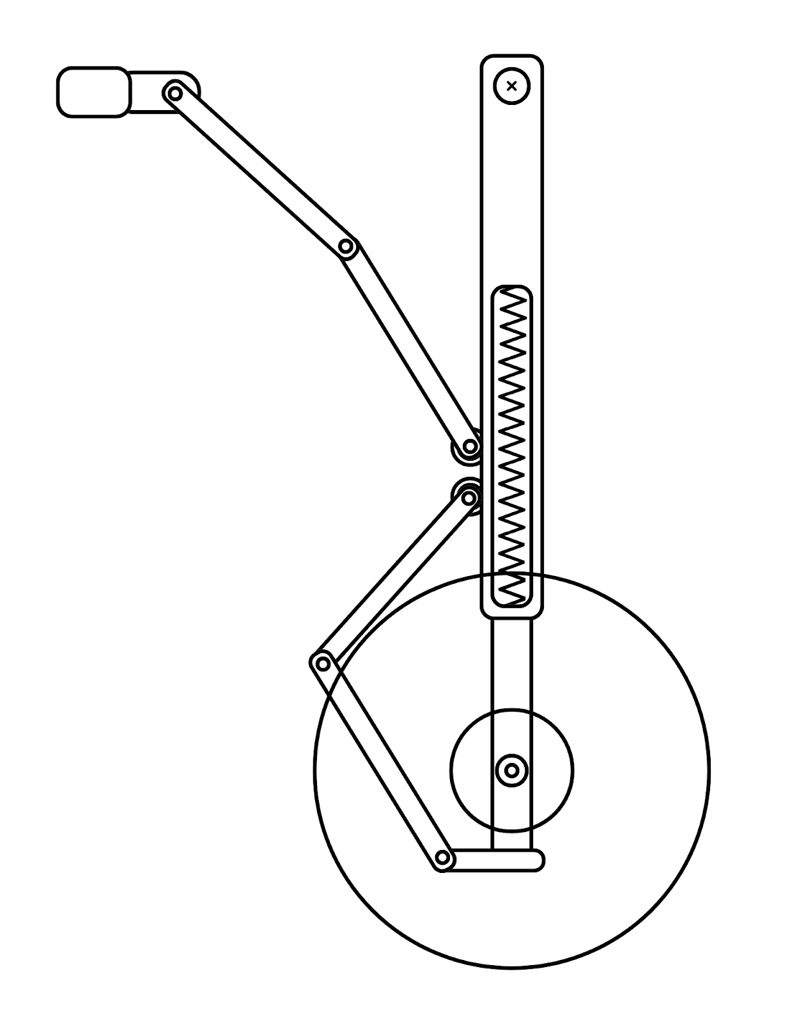
THE F-14 DESIGN CONTEXT
UNIQUE ENGINEERING CONSTRAINTS
Material limits: lower strength, brittle behavior, and layer-dependent failure
Manufacturing tolerances: surface roughness and dimensional error affect joints
Joint performance: higher friction, wear, and tolerance stack-up in pivots
Shock absorption: no printable damping → simplified spring-based suspension
Fasteners: printed holes creep; metal pins required for reliability
Testing limits: qualitative behavior only, not full-scale validation

Slide 5




KEY MECHANICAL SUB-SYSTEMS
TRUNNION ASSEMBLY
DRAG BRACE
The primary pivot structure. Features an angled axis to induce wheel rotation during retraction.
A folding linkage that acts as a structural column when extended, mechanically locking the gear.

Slide 6
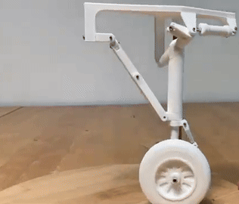

KINEMATICS & MOTION PATH
THE "TWIST AND TUCK"
To fit the large main wheel into the narrow fuselage, the mechanism utilizes an skewed trunnion axis.
Degrees of Freedom: 1 DOF
Motion Path: As the gear rotates 90° UP about the trunnion, the skew angle forces the wheel to rotate 90° IN.
Result: The wheel lies flat, minimizing the cross-sectional area of the aircraft for supersonic flight.

Slide 7
FAILURE MODES ANALYSIS
Failure Mode | Potential Cause | System Effect | Severity
Fatigue Cracking | Repeated high-stress carrier landings (High Cycle). | Catastrophic structural failure of main strut. | CRITICAL
Drag Brace Collapse | Failure of over-center locking mechanism or spring fatigue. | Gear retracts on touchdown (Gear Collapse). | CRITICAL
Seal Leakage | Corrosion pitting or seal wear from debris. | Loss of damping fluid; "Bottoming out" on landing. | MAJOR
Linkage Jamming | Foreign Object Debris (FOD) in wheel well. | Failure to extend/retract fully. | MAJOR

Slide 8
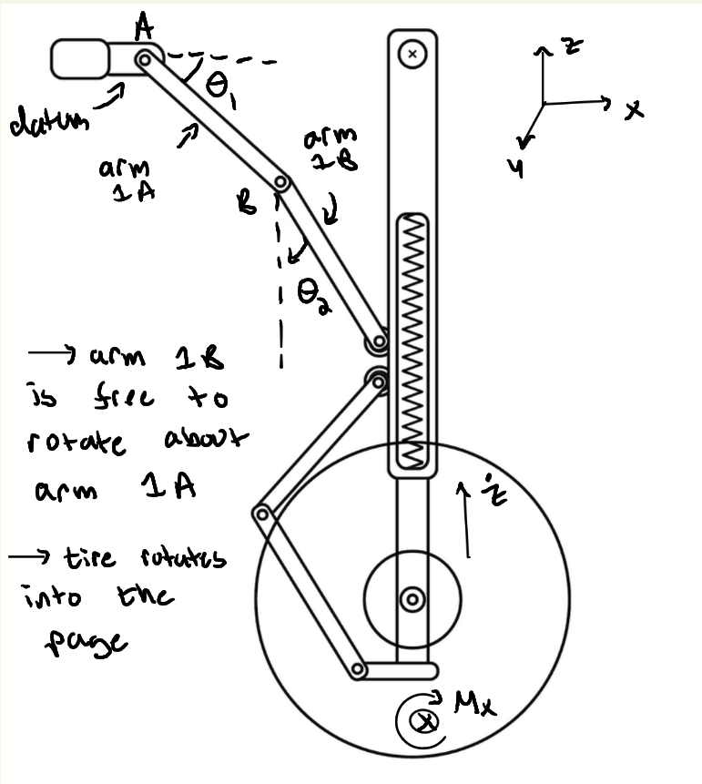

DESIGN FOR PROTOTYPING
MODELING CONSTRAINTS
Transitioning from aerospace alloys (300M Steel) to rapid prototyping materials (PLA/PETG) requires geometric modification.
▪
Scale Factors: Kinematic fidelity is prioritized over load capacity.
▪
Tolerance: 3D printed holes are undersized; post-processing is required for smooth linkage operation.
▪
Simplification: Hydraulic actuators are replaced with manual or servo-driven linear actuators for the model.

Slide 9
CONCLUSION & FUTURE WORK
The F-14 landing gear represents a triumph of mechanical packaging. This project successfully modeled the kinematic dependencies required to achieve the complex retraction path. Future work will focus on FEA validation of the prototype links and integration of active control for dampening.

Slide 10
THANK YOU

